Slide 1
What is DBMS?

Slide 2
A database management system (DBMS) is system software for creating and managing databases. The DBMS provides users and programmers with a systematic way to create, retrieve, update and manage data.

Slide 3
The DBMS essentially serves as an interface between the database and end users or application programs, ensuring that data is consistently organized and remains easily accessible.

Slide 4
What is database schema?

Slide 5
The database schema of a database system is its structure described in a formal language supported by the database management system .
The term "schema" refers to the organization of data as a blueprint of the database being constructed.

Slide 6
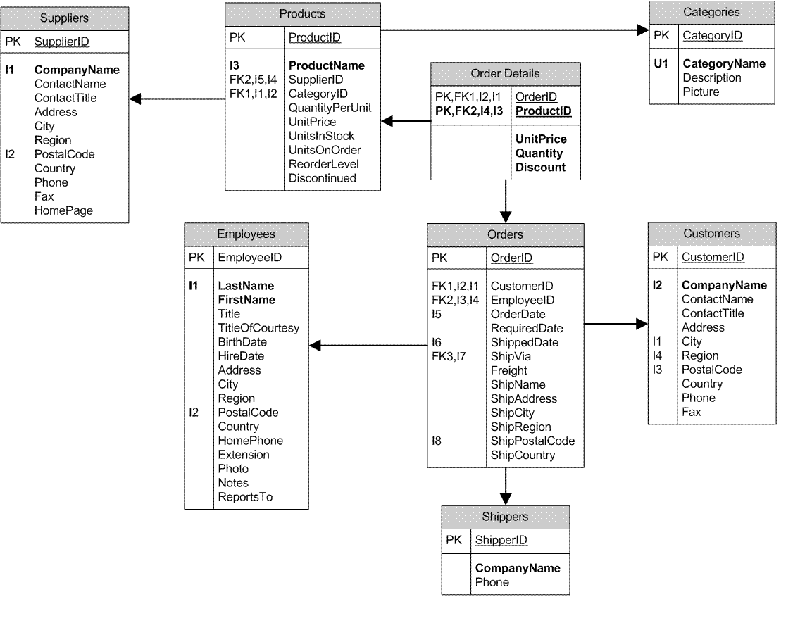

Slide 7
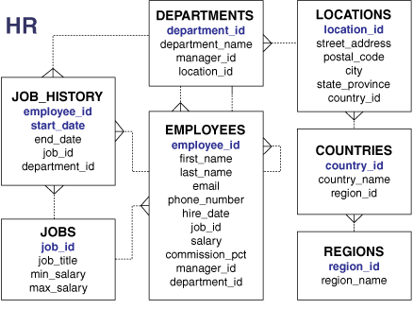

Slide 8
MySQL

Slide 9
MySQL is a relational database management system.
It is open-source and free.
MySQL database performs the following operations such as insert record, update record, delete record, select record, create table, drop table etc.

Slide 10
MySQL is a fast, easy to use relational database.
It is very commonly used in conjunction with PHP scripts to create powerful and dynamic server-side applications.

Slide 11
MySQL is an open-source database
MySQL is a very powerful program so it can handle a large set of functionality of the most expensive and powerful database packages.
MySQL is quicker than other databases so it can work well even with the large data set.
MySQL supports many operating systems with many languages like PHP, PERL, C, C++, JAVA, etc.

Slide 12
MySQL is very friendly with PHP.
MySQL supports large databases, up to 50 million rows or more in a table.

Slide 13
What are the features of MySQL?

Slide 14
MySQL is a relational database management system.
It is secure: MySQL consist of a solid data security layer that protects sensitive data from intruders. Passwords are encrypted in MySQL.
MySQL follows a client /server architecture.

Slide 15
4) It is scalable: MySQL can handle almost any amount of data, up to as much as 50 million rows or more.
5) Compatible on many operating systems
6) Allows roll-back: MySQL allows transactions to be rolled back, commit and crash recovery.
7) High performance, flexibility & productivity.

Slide 16
MySQL Data Types

Slide 17
The data types are classified into 3 main categories-
Numeric type
date and time and
string type

Slide 18
Numeric type

Slide 19
INT-
If signed, the allowable range is from -2147483648 to 2147483647.
If unsigned, the allowable range is from 0 to 4294967295.
The width is up to 11 digits.

Slide 20
2) TINYINT-
If signed, the allowable range is from -128 to 127.
If unsigned, the allowable range is from 0 to 255.
The width is up to 4 digits.

Slide 21
3) SMALLINT-
If signed, the allowable range is from -32768 to 32767.
If unsigned, the allowable range is from 0 to 65535.
The width is up to 5 digits.

Slide 22
4) MEDIUMINT-
If signed, the allowable range is from -8388608 to 8388607.
If unsigned, the allowable range is from 0 to 16777215.
The width is up to 9 digits.

Slide 23
5) BIGINT-
If signed, the allowable range is from -9223372036854775808 to 9223372036854775807.
If unsigned, the allowable range is from 0 to 18446744073709551615.
The width is up to 20 digits.

Slide 24
6) FLOAT(m,d)-
The display length (m) and the number of decimals (d).
This is not required and will default to 10,2, where 2 is the number of decimals and 10 is the total number of digits (including decimals).

Slide 25
7) DOUBLE(m,d)-
The display length (m) and the number of decimals (d). This is not required and will default to 16,4, where 4 is the number of decimals.

Slide 26
Date and Time Data Type:

Slide 27
DATE-
Values range from '1000-01-01' to '9999-12-31'.
Displayed as 'yyyy-mm-dd'.
2) TIME-
Values range from '-838:59:59' to '838:59:59'.
Displayed as 'HH:MM:SS'.

Slide 28
String Data Types

Slide 29
1) CHAR(size)-
Maximum size of 255 characters.
2) VARCHAR(size)-
Maximum size of 255 characters.
3) TEXT(size)-
Maximum size of 65,535 characters.

Slide 30
4) MEDIUMTEXT(size)-
Maximum size of 16,777,215 characters.
5) LONGTEXT(size)-
Maximum size of 4GB or 4,294,967,295 characters.
6) BINARY(size)-
Maximum size of 255 characters.

Slide 31
Large Object Data Types (LOB) Data Types

Slide 32
BLOB(size)-
Maximum size of 65,535 bytes.

Slide 33
MySQL Create Database

Slide 34
Syntax:
CREATE DATABASE database_name;
Ex-
CREATE DATABASE studentinfo;

Slide 35
SHOW DATABASES;
It is a command used to display all the databases available in the system.

Slide 36
MySQL SELECT Database
SELECT Database is used in MySQL to select a particular database to work with.

Slide 37
Syntax:
USE database_name;
Ex-
USE employees;

Slide 38
MySQL Drop Database
It is used to delete/remove a MySQL database easily with the MySQL command.

Slide 39
Syntax:
DROP DATABASE database_name;
Ex-
DROP DATABASE employees;

Slide 40
MySQL CREATE TABLE
The MySQL CREATE TABLE command is used to create a new table into the database & it requires 3 fields to create it:
Name of the table
Names of fields
Definitions for each field

Slide 41
Syntax:
CREATE TABLE table_name (column_name column_type...);
Ex-
CREATE TABLE student_info(name char(50),rollno int not null,course char(50));

Slide 42
SHOW tables;
It is a command used to display all the tables in the database.

Slide 43
DESCRIBE table_name;
It is used to display all the fields of the table with description.
Ex-
DESCRIBE student_info;

Slide 44
MySQL ALTER Table
MySQL ALTER statement is used when you want to change the name of your table or any table field. It is also used to add or delete an existing column in a table.
The ALTER statement is always used with "ADD", "DROP" and "MODIFY" commands according to the situation.

Slide 45
ADD a column in the table
ALTER TABLE table_name
ADD new_column_name column_definition
table_name: It specifies the name of the table that you want to modify.
new_column_name: It specifies the name of the new column that you want to add to the table.
column_definition: It specifies the data type and definition of the column (NULL or NOT NULL, etc).

Slide 46
Ex-
alter table student_info add address char(50)
not null;

Slide 47
SELECT* FROM table_name;
Ex-
SELECT * FROM student_info;

Slide 48
Add multiple columns in the table
Syntax:
ALTER TABLE table_name
ADD new_column_name column_definition
[ FIRST | AFTER column_name ],
ADD new_column_name column_definition
[ FIRST | AFTER column_name ],
...
;

Slide 49
Ex-
alter table student_info add age int not null after name;

Slide 50
MODIFY column in the table
The MODIFY command is used to change the column definition of the table.
Syntax:
ALTER TABLE table_name
MODIFY column_name column_definition
[ FIRST | AFTER column_name ];

Slide 51
Ex-
alter table student_info modify age int null;

Slide 52
DROP column in table
Syntax:
ALTER TABLE table_name
DROP COLUMN column_name;

Slide 53
Ex-
alter table student_info drop column address;

Slide 54
RENAME column in table
Syntax:
ALTER TABLE table_name
CHANGE COLUMN old_name new_name
column_definition
[ FIRST | AFTER column_name ]

Slide 55
RENAME column in table
Syntax:
ALTER TABLE table_name
CHANGE COLUMN old_name new_name
column_definition
[ FIRST | AFTER column_name ]

Slide 56
Ex-
alter table student_info change column name stud_name char(50) not null;

Slide 57
RENAME table
Syntax:
ALTER TABLE table_name
RENAME TO new_table_name;

Slide 58
Ex-
alter table student_info rename to student_data;

Slide 59
MySQL TRUNCATE Table
MYSQL TRUNCATE statement removes the complete data without removing its structure.
The TRUNCATE TABLE statement is used when you want to delete the complete data from a table without removing the table structure.

Slide 60
Syntax:
TRUNCATE TABLE table_name;
Ex-
TRUNCATE TABLE student_data;

Slide 61
DROP Table
DROP table statement removes the complete data with structure.
DROP TABLE table_name;

Slide 62
What is the difference between truncate & drop table command?

Slide 63
DROP TABLE command is used to delete complete table but it will remove complete table data and structure both.
TRUNCATE TABLE, it removes only table data not structure.

Slide 64
UPDATE Query
MySQL UPDATE statement is used to update data of the MySQL table within the database. It is used when you need to modify the table.
Syntax:
UPDATE table_name SET field1=new-value1, field2=new-value2 [WHERE Clause] ;

Slide 65
Ex-
Query to change the delete the column in table

Slide 66
What is primary key?

Slide 67
The primary key is the unique value in the attribute of the table.

